Slide 1
Step 17 - Push banking application in git

Slide 2
Here the steps
We are going the push the project may develop in local machine or virtual lap to git repository.
This folder contains backend and frontend project develop using angular and express js with node js.
Docker compose file is responsible to run the three contains
Angular container
Express js container
Node js container.

Slide 3
Running Banking application
Create separate folder and copy and paste
my-banking-app-backend
my-banking-app-frontend
Create two new files
docker-compose.yml
Jenkinsfile

Slide 4
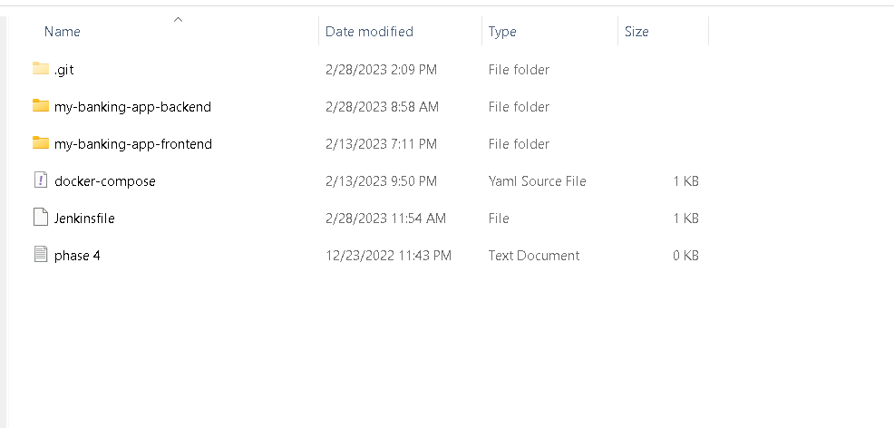
Project structure

Slide 5
Create remote repository in github account
Then in local machine run below command
git init
git add .
git commit –m “running capstone project ready”
git remote add origin URL
Ex: git remote add origin https://github.com/Kaleakash/RunningBankingApp.git
git push –u origin HEAD

Slide 6
The complete project ready in git repository

